Slide 1
Project Name : Flight Delay Analysis
Group-5
Team Members:-
Mr. Rushikesh Mahendra Nikam
Mr. Harshal Pandit Bhagat
Mr. Ameet Pradeep Ghodeswar
Miss Mitali Chandrashekhar Bokil
Mr. Raviraj Singh

Slide 2
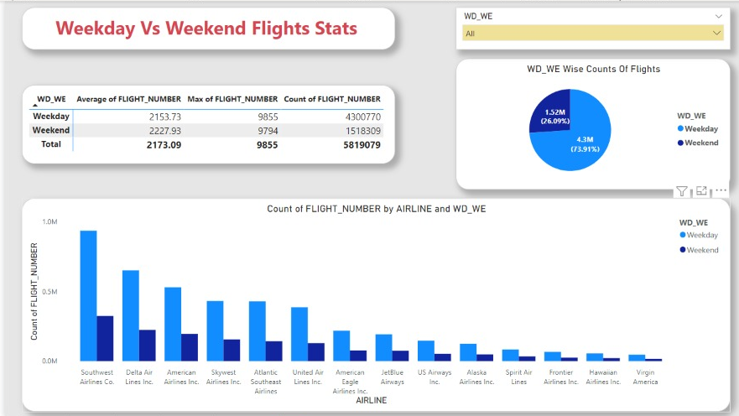
Weekday Vs Weekend total flights statistics
The following is the Table that explains Flight statistics according to weekend and weekday.(Average of flight Number, Maximum of Flight Number & Count of Flight Number).
Pie Chart is showing the Weekend (1.52M)& the Weekdays(4.3M) Counts of the flight .
Bar Chart showing the Count of Flight numbers by different Airlines According to Weekend & Weekdays.

Slide 3
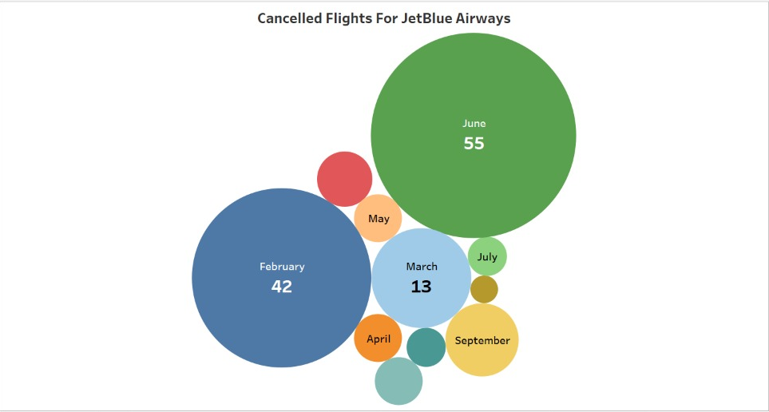
Total number of cancelled flights for JetBlue Airways on first date of every month
In the following Visualisation, We are showing that the Count of Total Cancelled Flights of Jet Airways in different months.

Slide 4
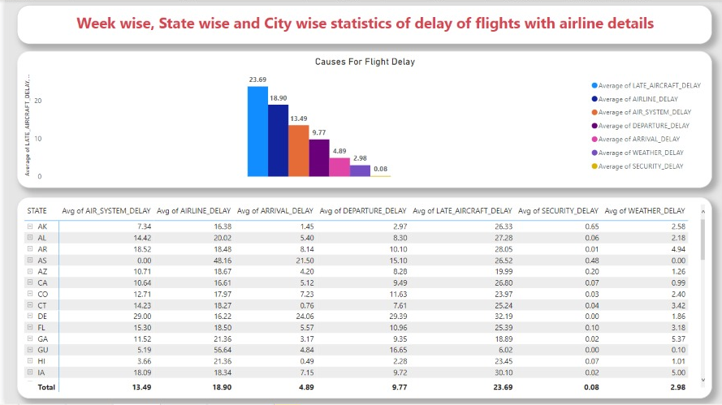
Week wise, State wise and City wise statistics of delay of flights with airline details
In the Following Slide, We are Visualizing Week wise, State wise & City wise Statistics of delay of flights with Airline details.
When we Calculated the Average of causes of flight delay, found that Highest (23.69) Aircraft delay Due to Late Aircraft.

Slide 5
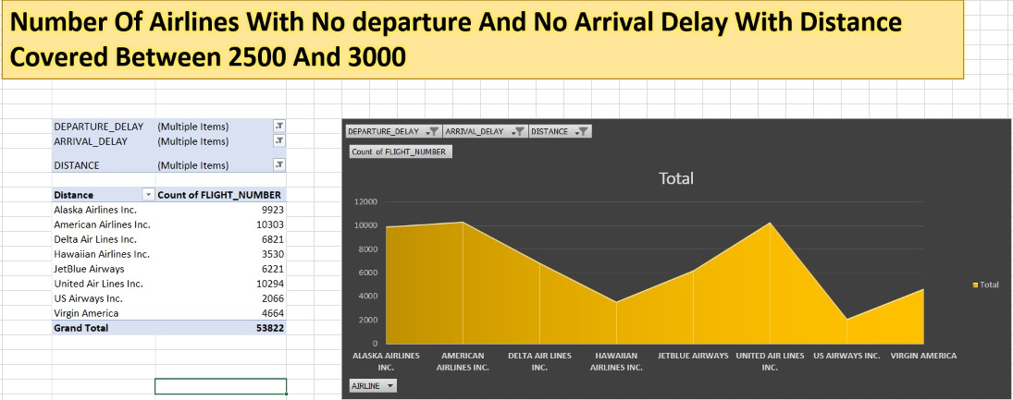
Number of airlines with No departure/arrival delay with distance covered between 2500 and 3000
In the following Visualization, We are using Pivot Table in MS Excel and found the total (53822) Flights with No Departure/Arrival delay with distance covered between 2500 and 3000.
In the Visualisation we are showing the Airlines Name and the count of flights numbers.

Slide 6

Thank You

